Slide 1

Deep learning for Computer Vision
Sandeep M A

Slide 2
Contents
Deep learning for computer vision
Image data preparation
Convolutions and pooling

Slide 3
What you’ll learn?
Concepts of computer vision
Concepts of deep learning
Platforms for building
Hands on implementation

Slide 4
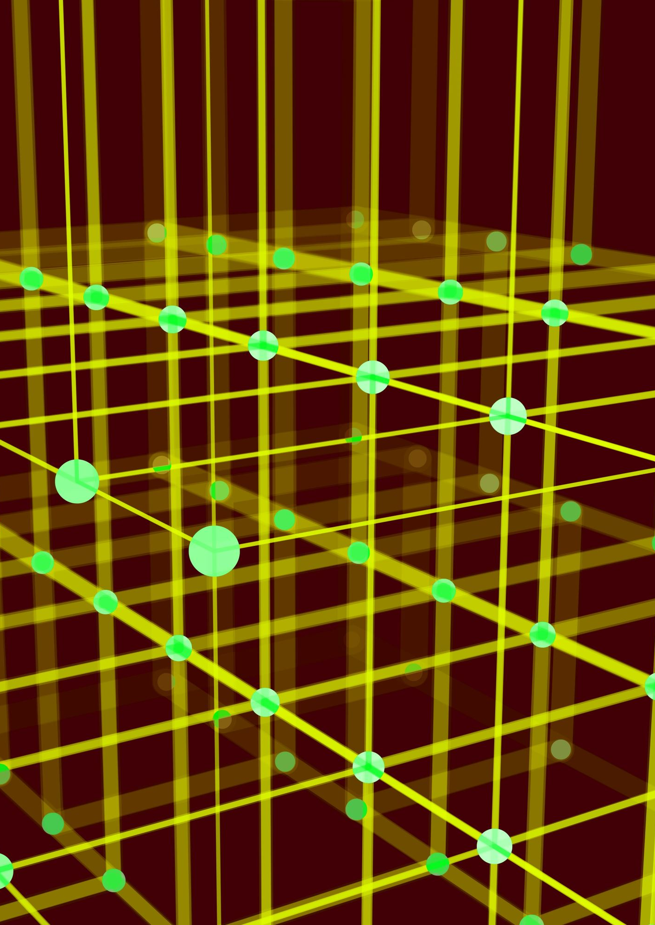
1- Image fundamentals
Going digital
Pixels
Channels
Coordinate system
Scaling and aspect ratio

Slide 5
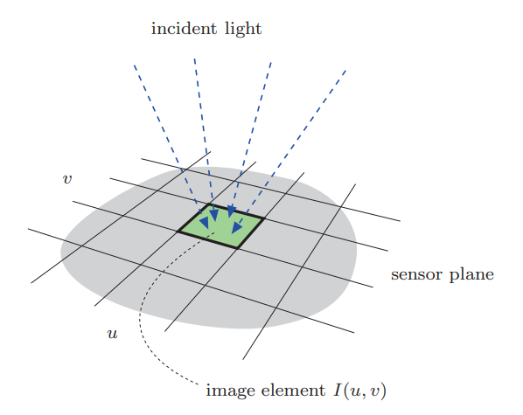
From analog camera to digital image
Analog camera lens | Digital image
Two dimensional | Spatially sampled
Time dependent | Temporarily sampled
Continuous distribution of light energy | Quantized
 | As a 2D function

Slide 6
EM spectrum and vision
VIBGYOR
Primary colours – Red, Blue and Green.
You can create different colours by mixing different intensities of primary colours.
https://www.csfieldguide.org.nz/en/interactives/rgb-mixer/

Slide 7
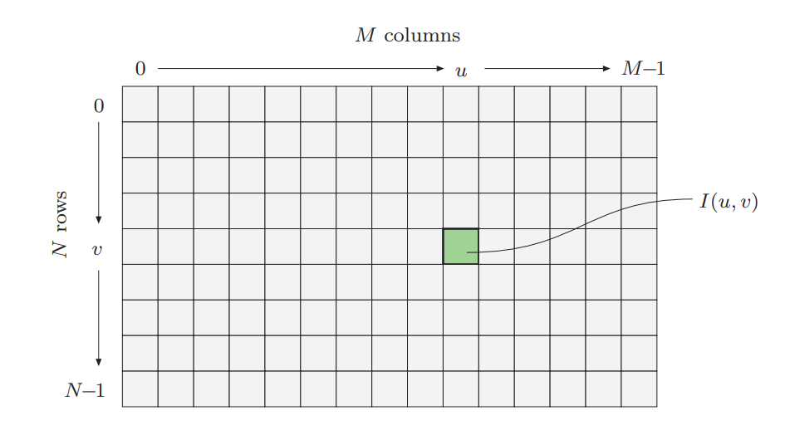
Image coordinate system
Each square – each pixel – carries an intensity magnitude.

Slide 8
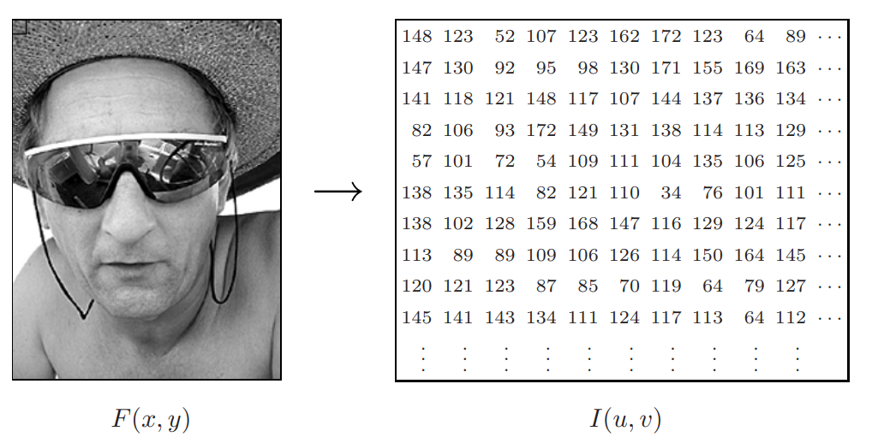

Slide 9
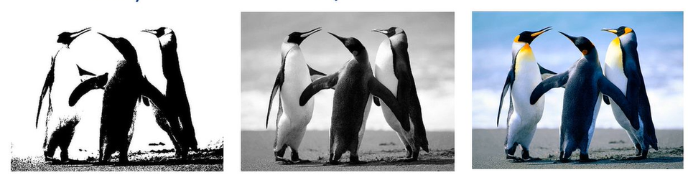
Common image types
Binary Grayscale Coloured

Slide 10
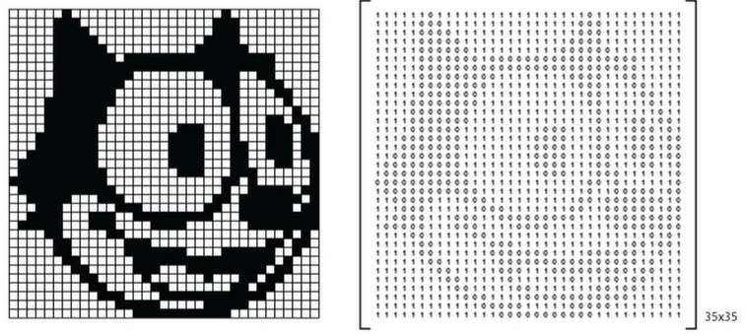
Example: Binary image
Only two intensity values – either 0 (black) or 1 (white).

Slide 11
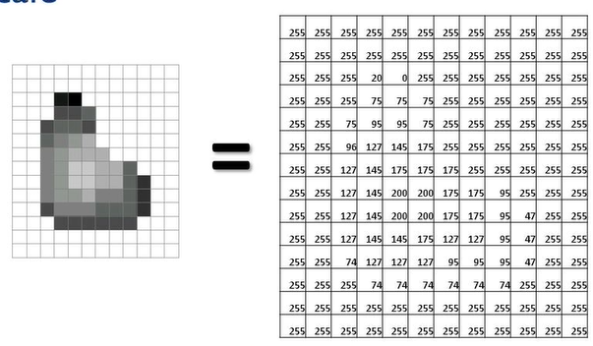
Example : Grayscale image
One channel, 0 – Black, 255 – White.

Slide 12
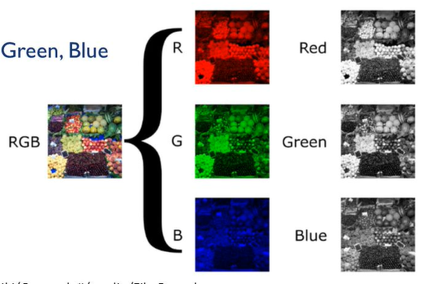
Example : Coloured images

Slide 13
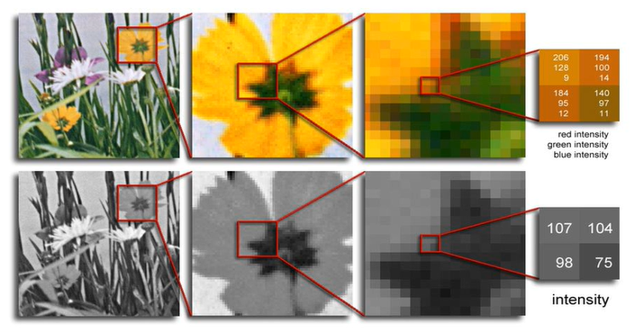
Example: Grayscale Vs Colour image

Slide 14
Let’s get dirty with OpenCV!
Basics of image data preparation.

Slide 15

Major points to discuss
Image transformation
Image arithmetic
Bitwise operations
Masking
Splitting and merging channels
Histograms
Smoothing and blurring
Edge detection

Slide 16
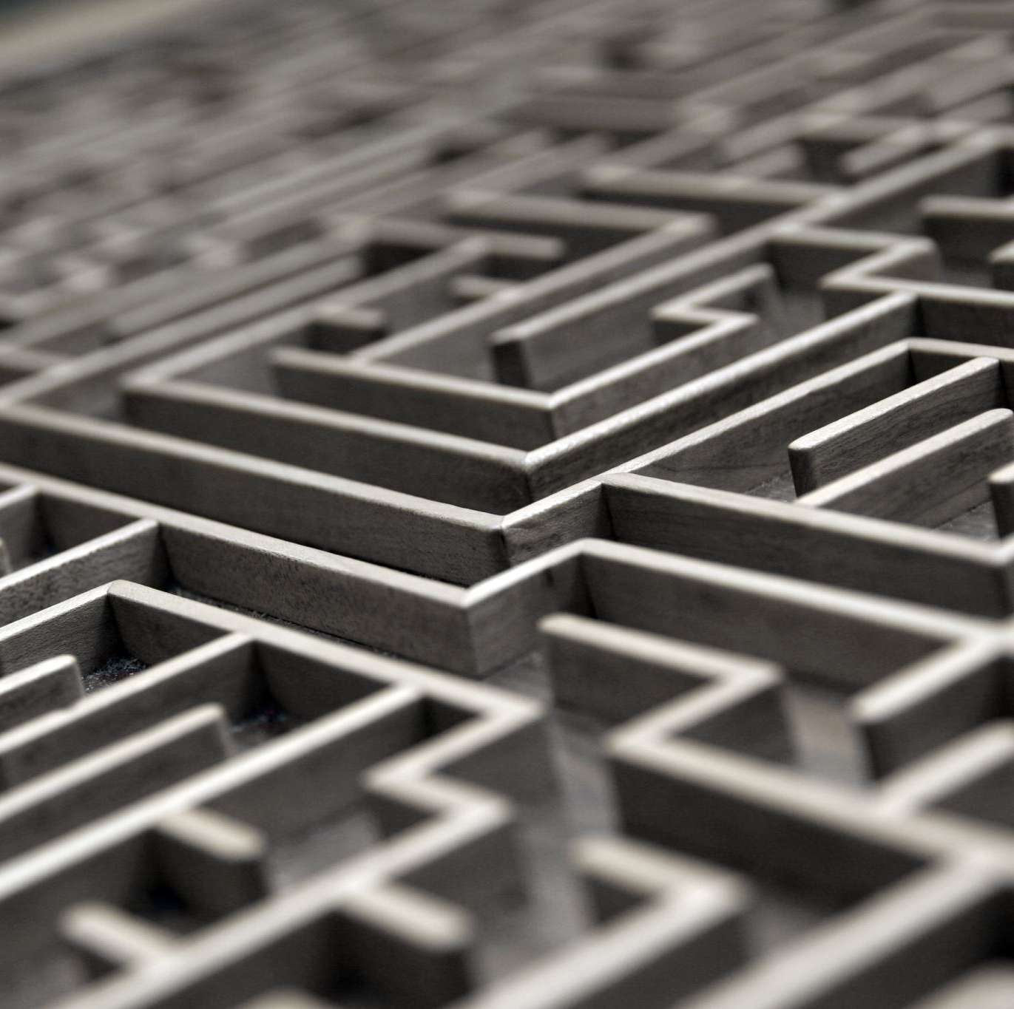
Image Transformation
Rotation: OpenCV allows you to rotate images by specifying the rotation angle and a pivot point, enabling easy reorientation for different perspectives.
Scaling: Image scaling can be performed using OpenCV's interpolation methods, which resize the image while preserving its aspect ratio.
Translation: You can shift an image's position horizontally or vertically using the warpAffine function in OpenCV.
Perspective Correction: OpenCV's getPerspectiveTransform and warpPerspective functions enable perspective correction by transforming quadrilateral regions into rectangular areas.

Slide 17

Image Arithmetic
Addition: Image addition in OpenCV combines corresponding pixel values of two images, which can be used for image blending or increasing brightness.
Subtraction: Image subtraction helps in tasks like background removal by comparing two images and obtaining the pixel value differences.
Multiplication: Image multiplication can be used for contrast adjustment and intensity scaling.
Division: Image division can be used for image normalization or creating different visual effects.

Slide 18
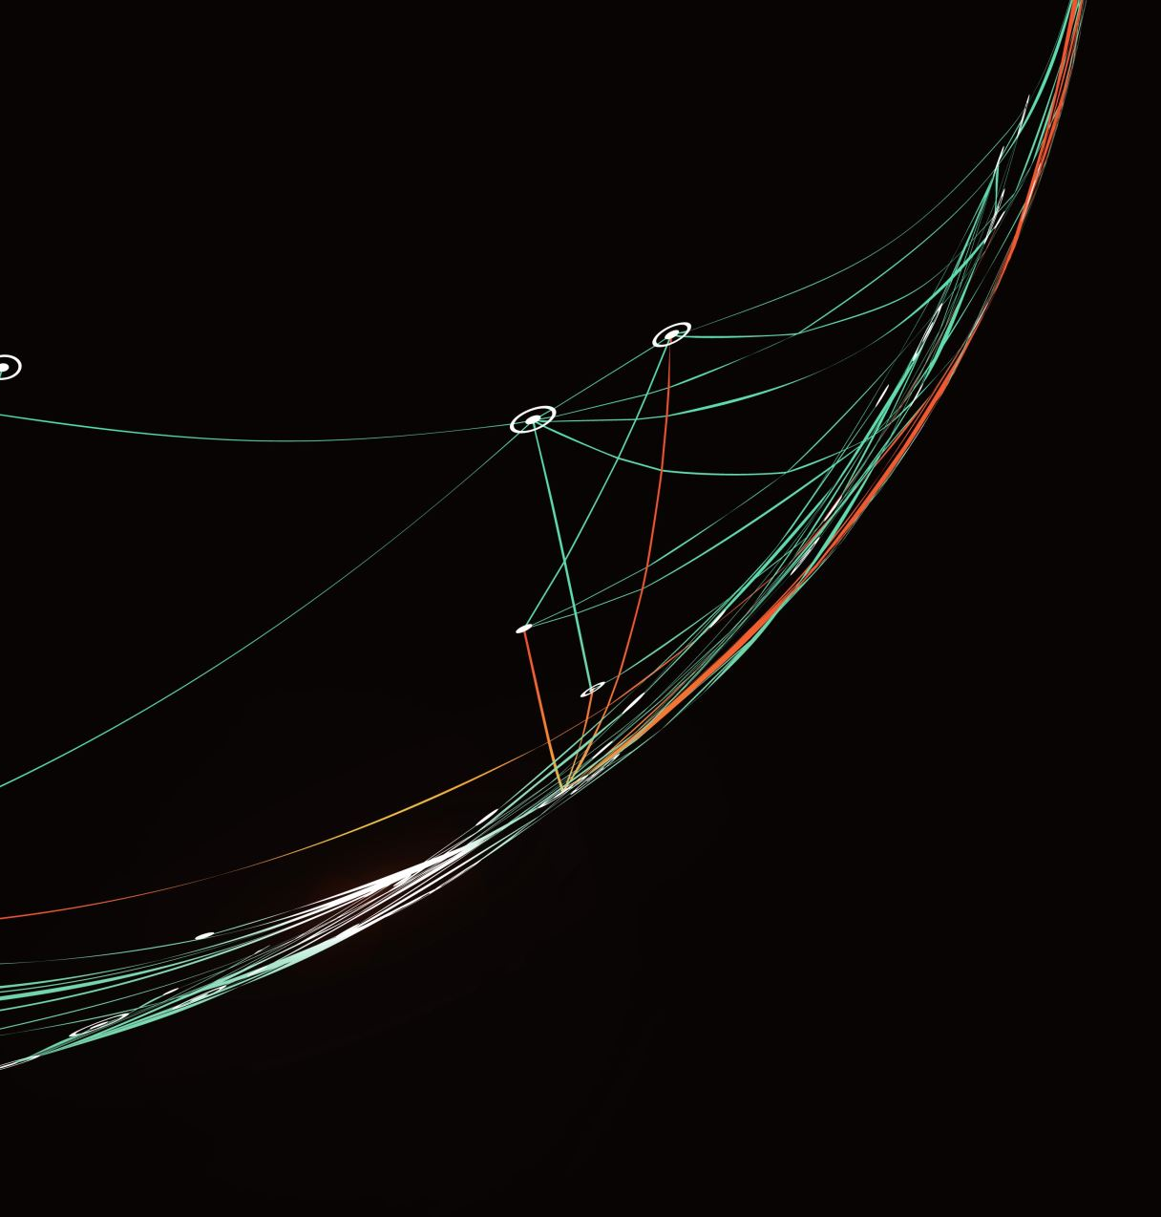
Bitwise Operations
AND: The bitwise AND operation in OpenCV performs a logical AND operation on the individual bits of two images, preserving only the common set pixels.
OR: The bitwise OR operation combines the set pixels from both images, resulting in a new image with the combined regions.
NOT: The bitwise NOT operation inverts the pixel values, converting the set pixels to unset and vice versa.
XOR: The bitwise XOR operation combines the set pixels from both images, excluding the common set regions.

Slide 19
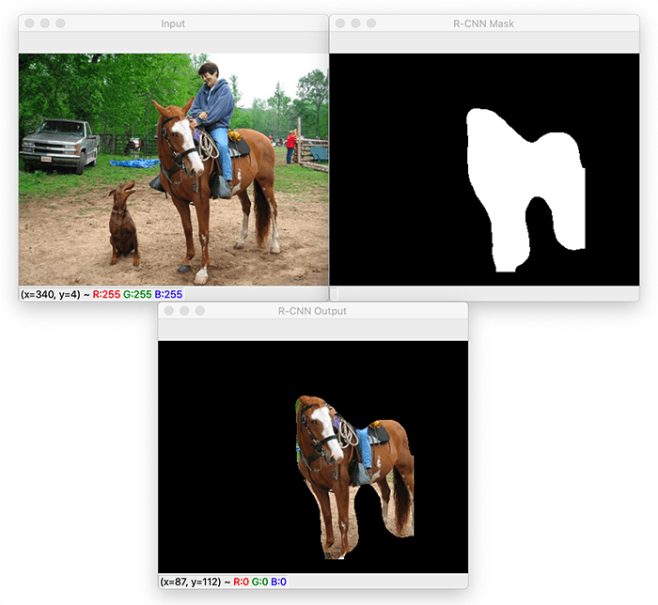
Masking
Creating a Mask: A mask is a binary image with the same size as the original image, specifying regions of interest.
Applying a Mask: You can apply a mask to an image using bitwise operations, showing only the regions where the mask pixels are set.
Region of Interest (ROI): Using a mask, you can extract specific parts of an image, such as a particular object or area.
Blending Images: Masking can be used for smooth image blending, gradually blending one image into another based on the mask's intensity.

Slide 20
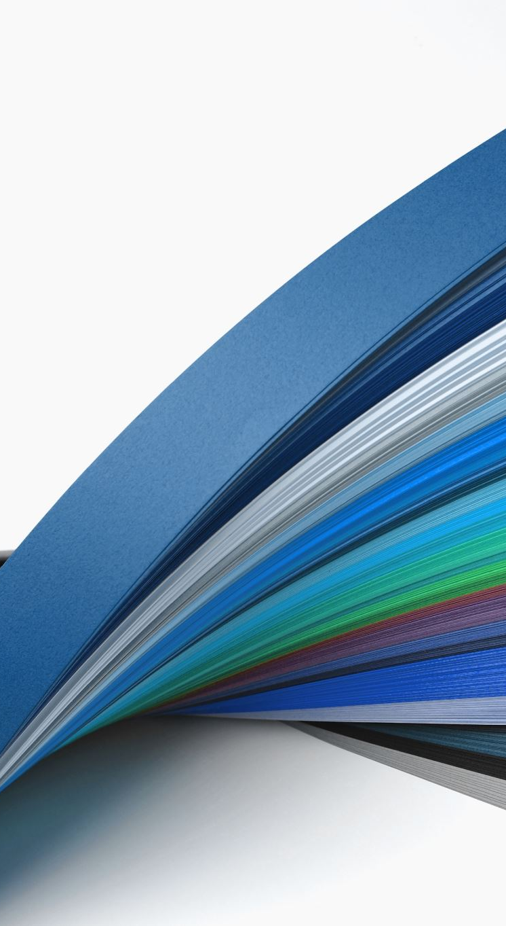
Splitting and Merging Channels
Splitting Channels: OpenCV allows you to split a multi-channel color image (e.g., RGB) into its individual color channels, creating separate grayscale images for each color component.
Accessing Individual Channels: Once the channels are split, you can access and process each channel independently, enabling operations on specific color information.
Color Manipulation: By modifying pixel values in individual channels, you can achieve color adjustments and creative effects, such as colorizing grayscale images.
Merging Channels: After processing individual channels, you can merge them back together to form the original color image, with the modified color components.

Slide 21
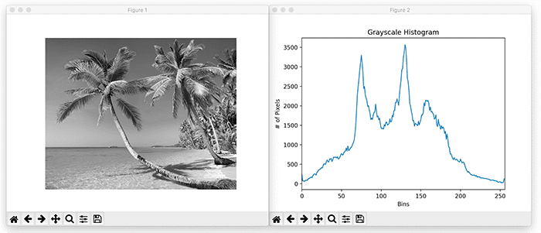
Histograms
Histogram Calculation: OpenCV provides functions to compute histograms of grayscale and color images, revealing the distribution of pixel intensities in the image.
Histogram Equalization: Histogram equalization enhances image contrast by redistributing pixel intensities to cover a wider range, making it useful for improving image visibility.
Histogram Visualization: OpenCV allows you to visualize histograms as bar charts, helping you understand the distribution of pixel values and identify image characteristics.
Histogram Backprojection: In applications like object tracking, you can use histogram backprojection to highlight regions in an image that match a given histogram, aiding in object localization.

Slide 22

Smoothing and Blurring
Gaussian Blur: OpenCV's GaussianBlur function applies a Gaussian filter to the image, reducing noise and achieving a smooth effect with controlled blurring.
Median Blur: The medianBlur function is effective for removing salt-and-pepper noise by replacing pixel values with the median value of neighboring pixels.
Bilateral Filter: OpenCV's bilateralFilter preserves edges while removing noise, making it suitable for applications where edge information is crucial.
Averaging and Box Filter: The blur and boxFilter functions perform simple averaging, effectively reducing noise but producing more noticeable blurring compared to Gaussian blur.

Slide 23
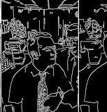
Edge Detection
Canny Edge Detection: OpenCV's Canny edge detector is a popular method for detecting edges in an image by identifying significant gradients.
Edge Thresholding: With the Canny edge detector, you can apply thresholding to control the detection of edges based on gradient magnitude.
Non-maximum Suppression: The Canny algorithm performs non-maximum suppression to thin out detected edges and obtain single-pixel-wide lines.
Hysteresis Thresholding: OpenCV's Canny edge detector implements hysteresis thresholding to connect and complete edges, producing more continuous edge contours.

Slide 24
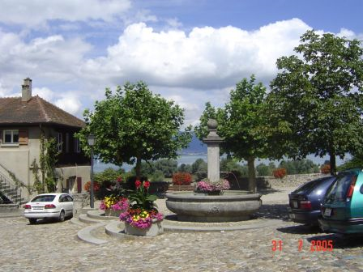
2- Computer Vision
What kind of scene?
Where are the cars?
How far is the building?
Make computers understand images and video.

Slide 25
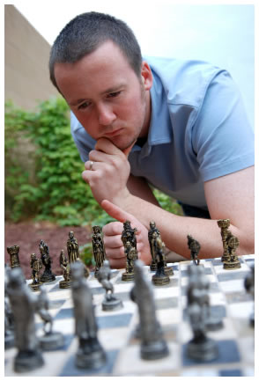
Vision is really hard
Vision is an amazing feat of natural intelligence
Visual cortex occupies about 50% of Macaque
brain.
More human brain devoted to vision than
anything else.
Is that a queen or a bishop?

Slide 26
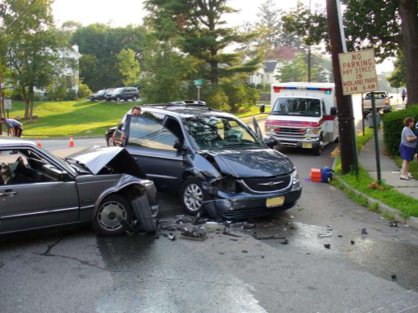
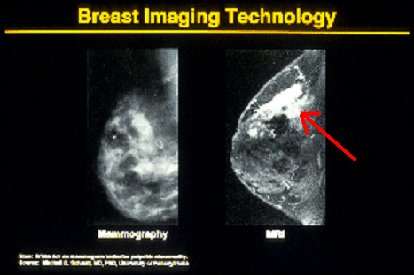
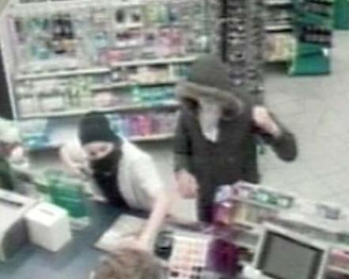
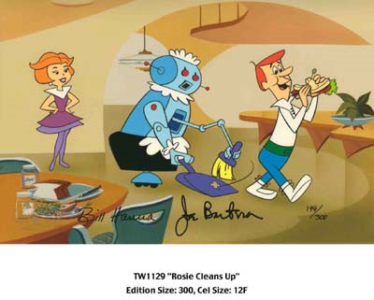
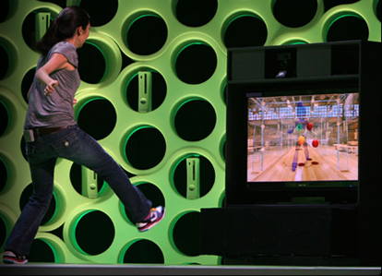
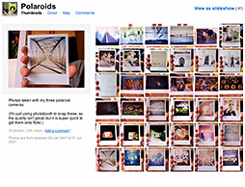
Why computer vision matters
Safety
Health
Security
Comfort
Fun
Access

Slide 27
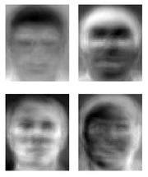
Ridiculously brief history of computer vision
1966: Minsky assigns computer vision as an undergrad summer project
1960’s: interpretation of synthetic worlds
1970’s: some progress on interpreting selected images
1980’s: ANNs come and go; shift toward geometry and increased mathematical rigor
1990’s: face recognition; statistical analysis in vogue
2000’s: broader recognition; large annotated datasets available; video processing starts
Guzman ‘68
Ohta Kanade ‘78
Turk and Pentland ‘91
Notes:
27

Slide 28
How vision is used now
Examples of state-of-the-art
Notes:
28

Slide 29
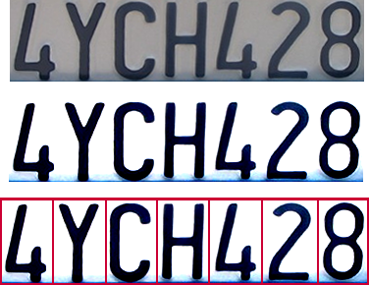

Optical character recognition (OCR)
Technology to convert scanned docs to text
If you have a scanner, it probably came with OCR software
Digit recognition, AT&T labs
http://www.research.att.com/~yann/
License plate readers
http://en.wikipedia.org/wiki/Automatic_number_plate_recognition
Notes:
29

Slide 30
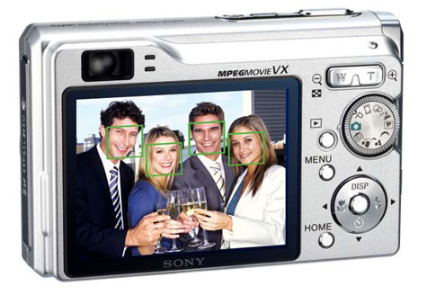
Face detection
Many new digital cameras now detect faces
Canon, Sony, Fuji, …
Notes:
30
Why would this be useful? Main reason is focus. Also enables “smart” cropping.

Slide 31
Smile detection
Sony Cyber-shot® T70 Digital Still Camera
Notes:
31

Slide 32
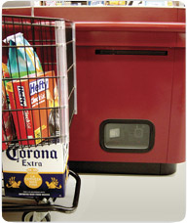
Object recognition (in supermarkets)
LaneHawk by EvolutionRobotics
“A smart camera is flush-mounted in the checkout lane, continuously watching for items. When an item is detected and recognized, the cashier verifies the quantity of items that were found under the basket, and continues to close the transaction. The item can remain under the basket, and with LaneHawk,you are assured to get paid for it… “
Notes:
32

Slide 33
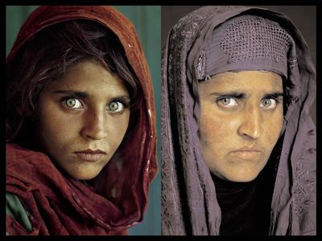
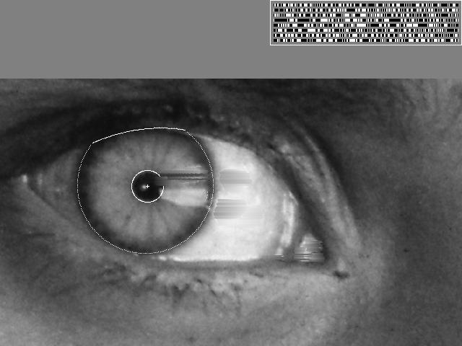
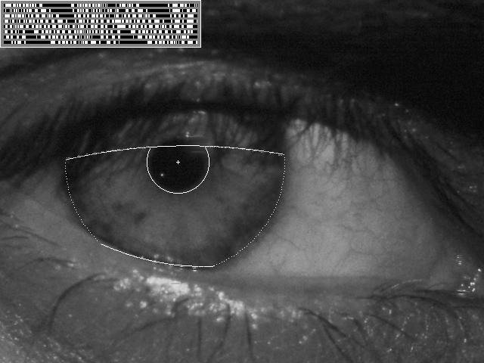
Vision-based biometrics
“How the Afghan Girl was Identified by Her Iris Patterns” Read the story
wikipedia
Notes:
33
Age 12, Age 30

Slide 34
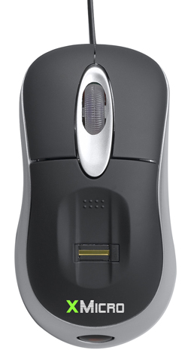
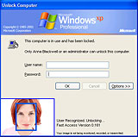
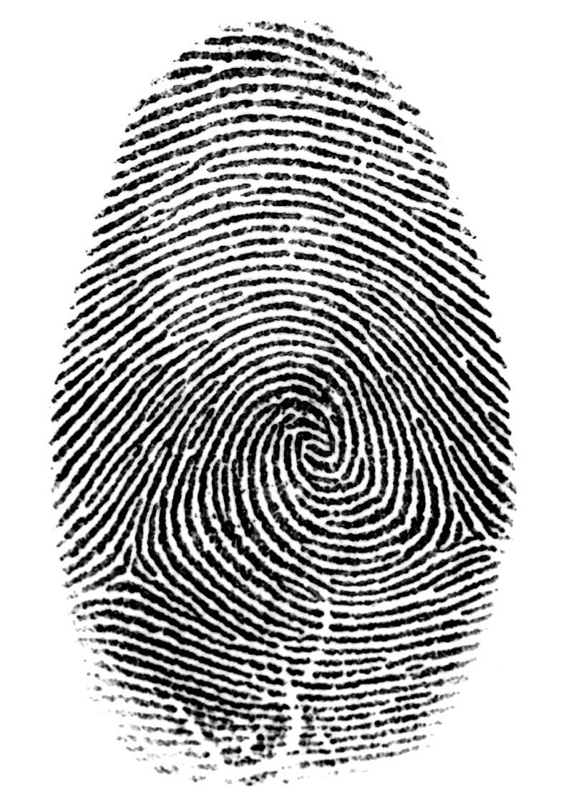

Login without a password…
Fingerprint scanners on many new laptops, other devices
Face recognition systems now beginning to appear more widely http://www.sensiblevision.com/
Notes:
34

Slide 35
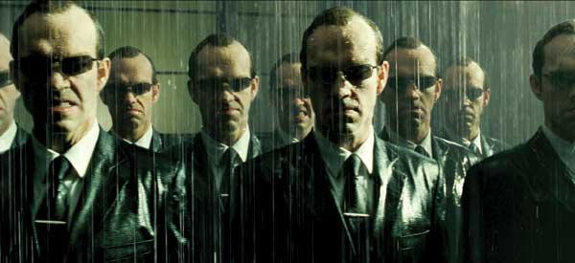
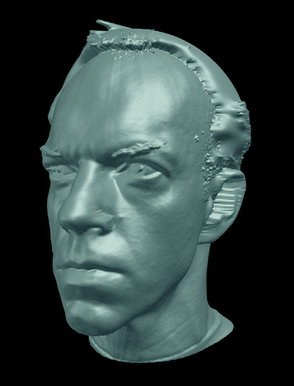
Special effects: shape capture
The Matrix movies, ESC Entertainment, XYZRGB, NRC
Notes:
35

Slide 36
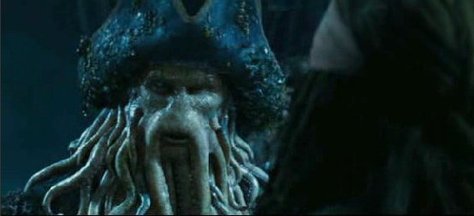
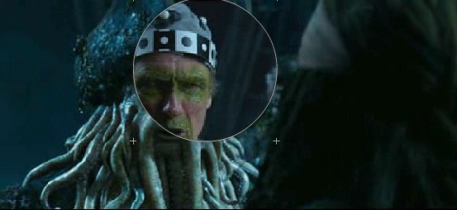
Special effects: motion capture
Pirates of the Carribean, Industrial Light and Magic
Notes:
36

Slide 37
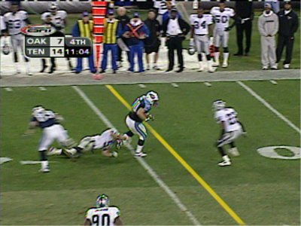
Sports
Sportvision first down line
Nice explanation on www.howstuffworks.com
http://www.sportvision.com/video.html
Notes:
37

Slide 38
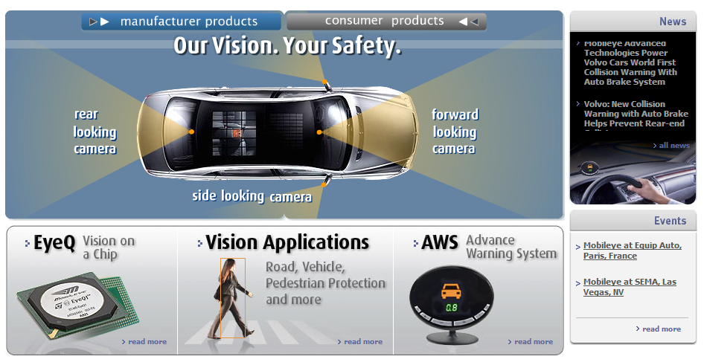
Smart cars
Slide content courtesy of Amnon Shashua
Mobileye
Vision systems currently in high-end BMW, GM, Volvo models
By 2010: 70% of car manufacturers.
Notes:
38

Slide 39
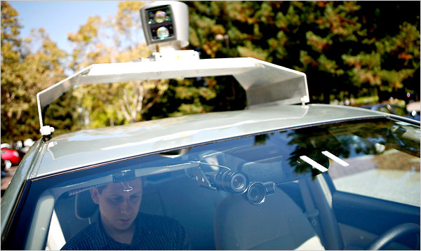
Google cars
http://www.nytimes.com/2010/10/10/science/10google.html?ref=artificialintelligence

Slide 40
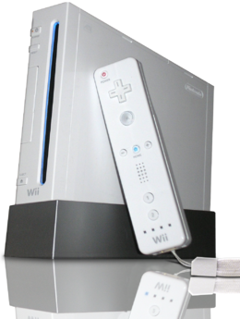
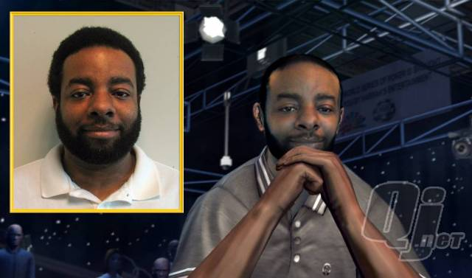
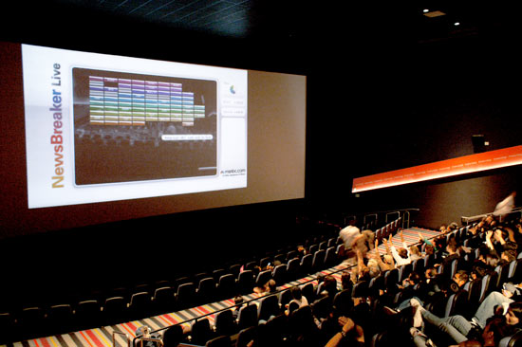
Vision-based interaction (and games)
Digimask: put your face on a 3D avatar.
Nintendo Wii has camera-based IR tracking built in. See Lee’s work at CMU on clever tricks on using it to create a multi-touch display!
“Game turns moviegoers into Human Joysticks”, CNET
Camera tracking a crowd, based on this work.
Notes:
40

Slide 41
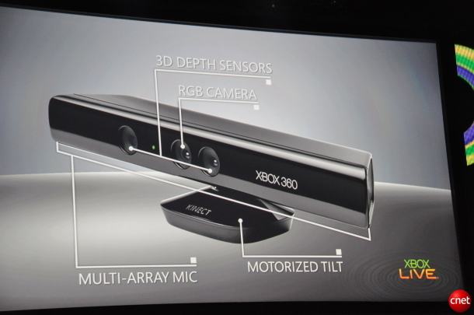
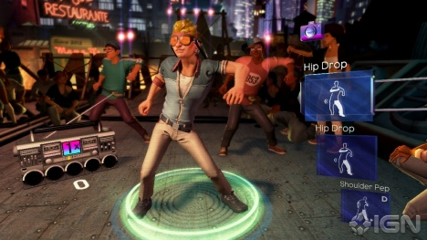
Interactive Games: Kinect
Object Recognition: http://www.youtube.com/watch?feature=iv&v=fQ59dXOo63o
Mario: http://www.youtube.com/watch?v=8CTJL5lUjHg
3D: http://www.youtube.com/watch?v=7QrnwoO1-8A
Robot: http://www.youtube.com/watch?v=w8BmgtMKFbY

Slide 42
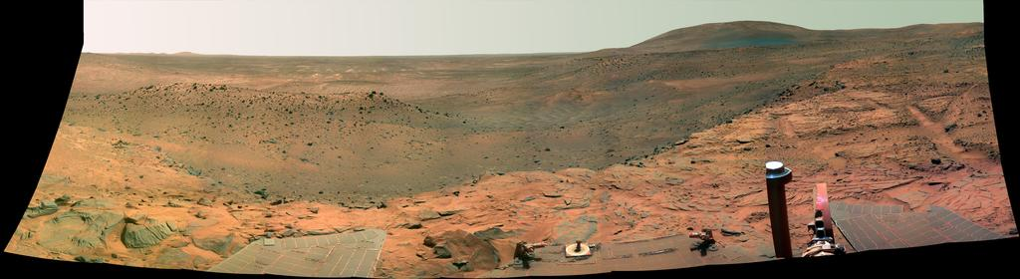
Vision in space
NASA'S Mars Exploration Rover Spirit captured this westward view from atop a low plateau where Spirit spent the closing months of 2007.
Vision systems (JPL) used for several tasks
Panorama stitching
3D terrain modeling
Obstacle detection, position tracking
For more, read “Computer Vision on Mars” by Matthies et al.
Notes:
42

Slide 43
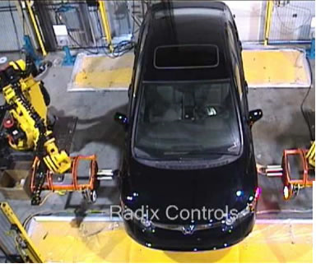
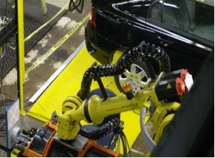
Industrial robots
Vision-guided robots position nut runners on wheels
Notes:
43

Slide 44

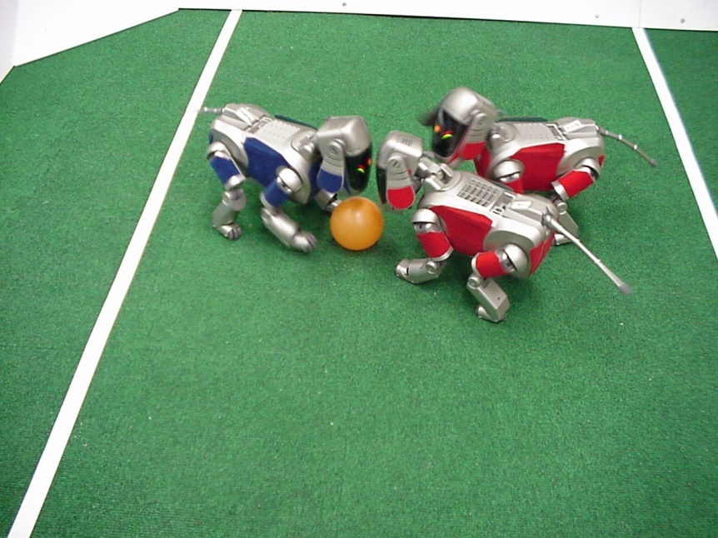
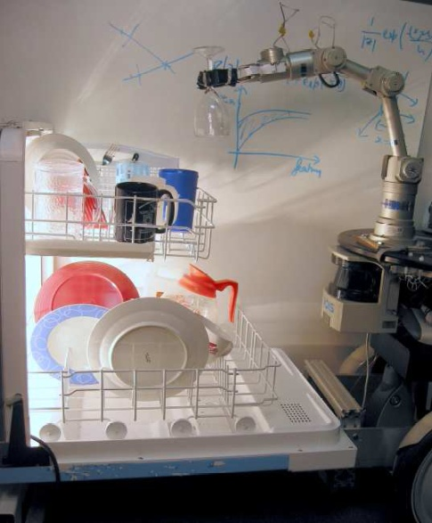
Mobile robots
NASA’s Mars Spirit Rover
http://en.wikipedia.org/wiki/Spirit_rover
http://www.robocup.org/
Saxena et al. 2008
STAIR at Stanford
Notes:
44

Slide 45


Medical imaging
3D imaging
MRI, CT
Image guided surgery
Grimson et al., MIT
Notes:
45

